Slide 1



Department of Computer Science and Engineering
Price Forecasting And Analysis OF Bitcoin
Team Members Name / Register Number
BHUVANESH R (211420104041)
GOKULANANTHAN K(211420104081)
Sustainable Development Goals-9(Industry, Innovation, and Infrastructure)
Guide Name & Designation
Mrs S PREENA JACITH SALOM M.E.
Coordinator Name & Designation
Dr. N.PUGHAZENDI M.E, PhD.

Slide 2
Introduction
Bitcoin is a cryptographic money which is utilized worldwide for advanced installment or basically for speculation purposes.
Bitcoin is decentralized for example it isn't possessed by anybody.
Bitcoins are put away in an advanced wallet which is essentially similar to a virtual financial balance. The record of the considerable number of exchanges, the timestamp information is put away in a spot called Block chain. Each record in a block chain is known as a square. Each square contains a pointer to a past square of information.
The information on block chain is scrambled. During exchanges the client's name isn't uncovered, however just their wallet ID is made open. The Bitcoin's worth fluctuates simply like a stock though in an unexpected way. There are various calculations utilized on financial exchange information for value forecast. Notwithstanding, the parameters influencing Bitcoin are extraordinary.

Slide 3
Sustainable Development Goals
1. SDG 9 - Industry, Innovation, and Infrastructure**: By leveraging AI technology to predict Bitcoin prices, the research contributes to advancing innovation in financial technology (FinTech) and strengthening infrastructure for digital payments and investments.
2. SDG 8 - Decent Work and Economic Growth**: Accurate predictions of Bitcoin prices can facilitate better investment decisions, potentially leading to economic growth and creating opportunities for decent work in the financial sector.
3. SDG 11 - Sustainable Cities and Communities**: The research aligns with SDG 11 by promoting sustainable development in the digital economy and fostering resilient and inclusive cities through advancements in financial technologies.

Slide 4
Objective of the Project
The objective of Bitcoin price prediction using machine learning (ML) algorithms is to make accurate forecasts of the future price movements of Bitcoin based on historical price data .
The main goal is to develop a model that can predict Bitcoin prices with high accuracy, enabling traders, investors, and other stakeholders to make informed decisions about buying or selling Bitcoin.

Slide 5
Abstract
Bitcoin, the ruler of cryptocurrency plays an important role in blockchain technology. - In this project, we proposed to predict the Bitcoin price accurately taking into consideration various parameters that affect the Bitcoin value.
we aim to understand and find daily trends in the Bitcoin market while gaining insight into optimal features surrounding Bitcoin price. Our data set consists of various features relating to the Bitcoin price and payment network over the course of every years, recorded daily.
Features such as the opening price, highest price, lowest price, closing price, volume of Bitcoin, volume of currencies, and weighted price were taken into consideration so as to predict the closing price of the next day.
Random forest model designed and implemented on scikit learn frameworks to build predictive analysis and evaluated them by computing various measures such as the RMSE (root mean square error) and r (Pearson's correlation coefficient) on test data.
Flask framework was used to make prediction in webpages and BeautifulSoup is used to scrap the data

Slide 6
Problem Statement
The challenge in Bitcoin price prediction using ml is to develop a model that can effectively capture the complex and non-linear relationships between the input features and Bitcoin prices.
High computational resources and a large amount of training data to achieve accurate results.
Unpredictable nature of the cryptocurrency market makes it difficult to develop a model that can provide reliable predictions.

Slide 7
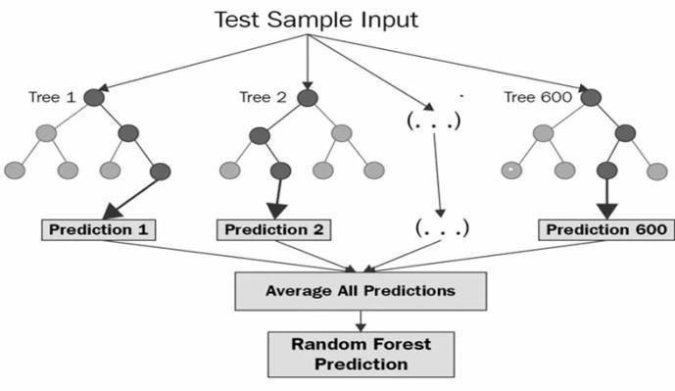
Algorithm
RANDOM FOREST A supervised machine learning approach for classification and regression issues is called Random Forest. It constructs a decision tree from several samples, using the majority vote for classification and the average in the case of regression. The purpose of training the random forest model is to forecast the closing price for the following day. The most basic definition of random forest is a collection of decision trees that are employed in regression and classification tasks. Once established, a decision tree classifies an unlabeled point by means of voting; the label or value that receives the greatest number of votes is carried by the random forest.

Slide 8
Literature Survey
Title with Author Name, Journal Detail, Year | Methods / Algorithm used | Parameters Used | Conclusion / Drawbacks/ Future Directions
Crypto-Currency price prediction using Decision Tree and Regression techniques Karunya Rathan1 , Somarouthu Venkat Sai2 , Tubati Sai Manikanta IEEE Xplore Part Number: CFP19J32-ART 2019 | Crypto-currency, Decision tree, Regression model, machine learning. | Dataset collection from quandl.com Dataset pre-processing Split dataset as train and test set Apply Machine learning Decision tree and linear regression | The proposed learning method suggest the best algorithm to choose and adopt for crypto currency prediction problem
Prediction of Bitcoin Prices with Machine Learning Methods using Time Series Data Zonguldak, Türkiye 2018 IEEE | Price Prediction; Support Vector Machine (SVM), Machine Learning | some distance function d(x,y), where x,y are scenarios composed Number of features, such that x={x1,…,xN}, y={y1,…,yN} . | e lines decreases issues originating from the scourge of dimensionality
DEPARTMENT OF COMPUTER SCIENCE AN56D ENGINEERING 2

Slide 9
Literature Survey
Title with Author Name, Journal Detail, Year | Methods / Algorithm used | Parameters Used | Conclusion / Drawbacks/ Future Directions
Real-Time Prediction of BITCOIN Price using Machine Learning Techniques and Public Sentiment AnalysisS M Rajua Ali Mohammad Tarif | Machine Learning; Sentiment Analysis; Tweet. | Sentiment Analysis, Data Collection Preprocessing | the current sentiments can be combined with the prediction of the LSTM model to influence the decision of an autonomous trading assistant to buy or sell Bitcoins
Time-series forecasting of Bitcoin prices using high-dimensional features: a machine learning approach Mohammed Mudassir1 Shada Bennbaia1Devrim UnalMohammadHammoudeh 16 June 2020Springer-Verlag London Ltd., part of Springer Nature 2020 | Time-series forecasting Deep learning _x0002_ Machine learning _x0002_ Blockchain | Data Fusion in the era od Data science | results show an improvement over the latest literature in daily closing price forecast and price increase/decrease forecasting
DEPARTMENT OF COMPUTER SCIENCE AND ENGINEERING 2

Slide 10
Existing system
The problem will solved by achieved with level of success through high implementation of a Bayesian regression. To optimized recurrent neural network (RNN) and a Long Short Term Memory (LSTM) network. The LST Achieves the highest classification accuracy of 52% and a RMSE of 8% .
The popular ARIMA model for time series forecasting is implemented as a comparison to the deep learning model. As expected, the non-linear deep learning methods outperform the ARIMA forecast which performs very low. So, Finally the both learning models are resulted the outcomes are very low level of accuracy.
Log Normalization: In this method, the range is compressed and we get the values that were close to zero before normalization. The function is: A'= log(A)/log(max)
Z score normalization: This method uses technique similar to standard deviation method by considering the mean value.

Slide 11
Disadvantage of Existing System
One drawback is there is no proof for transaction.
Conversion will be late.
It takes long time to solve the data set.
It is a long process for filter the data.
Low redundancy to perform the prediction.

Slide 12
Proposed System
In this study, we have used 5 years data sets for Bitfinex for testing and training the ML . With the help of python libraries, the data preprocessing was done.
Python has provided with a best feature for data Analysis and visualization. After the understanding of the data, we trim the data and use the features or attributes best suited for the model.
It was discovered that the random forest model’s accuracy rate is very high when compared to other Machine Learning models from related works.
In this work, a flask framework has been created using the flask library that will allow the user to input the future date to be predicted . BeautifulSoup is used to scrap the data from 'url': 'https://bitinfocharts.

Slide 13
Advantage of Proposed System
The Advantage of RF in Bitcoin price prediction results has been showed in with good rmse and mse values.
It helps to understand the results very neatly in webpage.
It works the prediction by taking the 'url': 'https://bitinfocharts.

Slide 14
Block diagram
Dataset(Kaggle 5 yrs)
Data pre-processing
Test/Train split
Algorithm
Grid search method
Evaluation
HTML,CSS
Final bitcoin prediction
Flask server
Today data from Bitinformatics
Web scrapping
Finalized model
User input

Slide 15




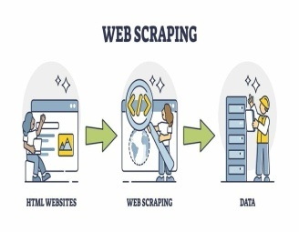




System Architecture of Proposed System
Training
Evaluation
DataSet
Machine learning
Algorithm
Web scraping
Data pre-processing
Splitting sample
Testing
Final Bitcoin
Prediction

Slide 16
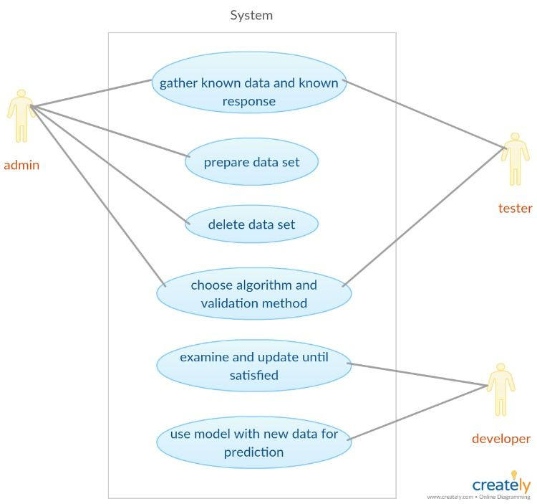
Use Case Diagram

Slide 17
MODULES
DATA COLLECTION:
bitfinex
OPEN PRICE: The open represents the first price traded during the candlestick.
HIGH PRICE: The high is the highest price traded during the candlestick.
LOW: The low shows the lowest price traded during the candlestick.
CLOSE: The close is the last price traded during the candlestick.
Volume (BTC): Volume, in BTC traded in the stock market during a given measurement interval.
Volume (Currency): Volume, in USD, traded on stock market during a given measurement interval.
Weighted Price: Measure of the average price

Slide 18
MODULES
Data Preprocessing:
Remove unwanted columns
Check nan values.

Slide 19
MODULES
Training – random Forest/linear regression – grid search method:-
Now we will fit the Random forest algorithm to the training set. To fit it, we will import the RandomForestClassifier class from the sklearn.ensemble library.
Grid search is a process that searches exhaustively through a manually specified subset of the hyperparameter space of the targeted algorithm. Random search, on the other hand, selects a value for each hyperparameter independently using a probability distribution.

Slide 20
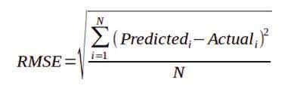
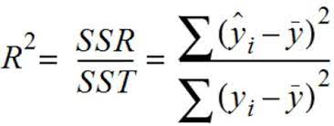
MODULES
Performance evaluation- testing
RMSE (Root Mean Square Error) - Root mean square error (RMSE) is a frequently used measure of the differences between values (sample or population values) predicted by a model or an estimator and the values observed.
r (Pearson’s Correlation Coefficient) The Pearson’s correlation coefficient depicts the linear association between two variables. It helps to figure if two sets of data move in the same direction.
DEPARTMENT OF COMPUTER SCIENCE AND ENGINEERING 2

Slide 21
MODULES
Web scraping: Steps involved in web scraping:
Send an HTTP request to the URL of the webpage you want to access. The server responds to the request by returning the HTML content of the webpage. For this task, we will use a third-party HTTP library for python-requests.
Once we have accessed the HTML content, we are left with the task of parsing the data. Since most of the HTML data is nested, we cannot extract data simply through string processing. One needs a parser which can create a nested/tree structure of the HTML data. There are many HTML parser libraries available but the most advanced one is html5lib.
Now, all we need to do is navigating and searching the parse tree that we created, i.e. tree traversal. For this task, we will be using another third-party python library, Beautiful Soup. It is a Python library for pulling data out of HTML and XML files.

Slide 22
MODULES
Flask Framework
A Web Application Framework or a simply a Web Framework represents a collection of libraries and modules that enable web application developers to write applications without worrying about low-level details such as protocol, thread management, and so on.
Flask is a web application framework written in Python.
Prediction is in webpage , it consider the current price from bioinformatics and calculate the future price

Slide 23
Software and Hardware Requirement
HARDWARE:
I7 INTEL
MORE THAN 8 GB RAM
STORAGE 1Tb
SOFTWARE:
OS: WINDOWS OR LINUX
TOOL: PYTHON AND R LAN

Slide 24
Future Enhancement
Generative Models Investigating the potential of generative adversarial networks (GANs) or variational autoencoders (VAEs) for generating synthetic data to augment limited historical datasets could enhance the robustness of forecasting models.
Long Term Role If the dataset contains several data it is possible to make this project helpful for long-term investors also. Because of its accuracy it will be helpful for long-term investors.

Slide 25
Conclusion
Based on the project's findings, it is evident that Bitcoin's price is influenced by various factors. The proposed predictive model, which incorporates multiple parameters, was able to accurately forecast Bitcoin's closing price for the following day. The model can be helpful for investors and traders looking to make informed decisions about buying or selling Bitcoin.

Slide 26
Reference
Time-series forecasting of Bitcoin prices using high-dimensional features: a machine learning approachMohammedMudassir1 Shada Bennbaia1Devrim Una lMohammad Hammoudeh 16 June 2020Springer-Verlag London Ltd., part of Springer Nature 2020.
Project Based Learning: Predicting Bitcoin Prices using Deep Learning‖ S. Yogeshwaran ; PiyushMaheshwari; ManinderJeet Kaur ; Amity University Dubai Dubai, UAE; IEEE 2019
Predicting the Price of Bitcoin Using MachineLearning‖ Sean McNally ; Jason Roche ; Simon Caton; Ireland, Dublin , IEEE 2018
Farokhmanesh, F., &Sadeghi, M. T. (2019). Deep Feature Selection using an Enhanced Sparse Group Lasso Algorithm. 2019 27th Iranian Conference on Electrical Engineering (ICEE).

